Slide 1
FYP Meeting: Materials and Methods Results
Anna Bakewell
Notes:
Comparative bioinformatic analysis of gene activity during mouse intestinal differentiation as a model for adult stem cell differentiation

Slide 2
Materials and methods: flow chart summary
Quality control
Adaptor trimming
Genome mapping
Filtering blacklist
Sorting and indexing BAM files
Converting BAM files to '.bigwig' format
Visualisation of mapped reads
Counting by gene
Generating DGEList of gene counts
Filtering and normalising gene counts
MultiBamSummary of read counts
Data visualisation and exploration
Estimating common dispersion
GO and KEGG pathway analyses
Exact test of DGEList
Generating lists of significantly up- and down-regulated genes
Notes:
Firstly, included background on where the samples came from and how the RNA-seq was carried out.
Outlined the QC steps for fastqc, cutadapt, hisat2 and feature counts.
Bigwig files used to visualise the mapped reads for chr11.
The exactTest assesses differential expression between two groups of count libraries and the difference in mean between two groups

Slide 3
Results:
QC report
Data visualisation and exploration – IGV plot, plotCorrelation, plotPCA
Gene counts – pheatmap, BCV plot, MDS plot
ExactTest of DGEList – MD plot
Table of significant DGE (up/down)
GO and KEGG pathway analyses
Notes:
Do I need to describe plots in methods or just in the results section?

Slide 4
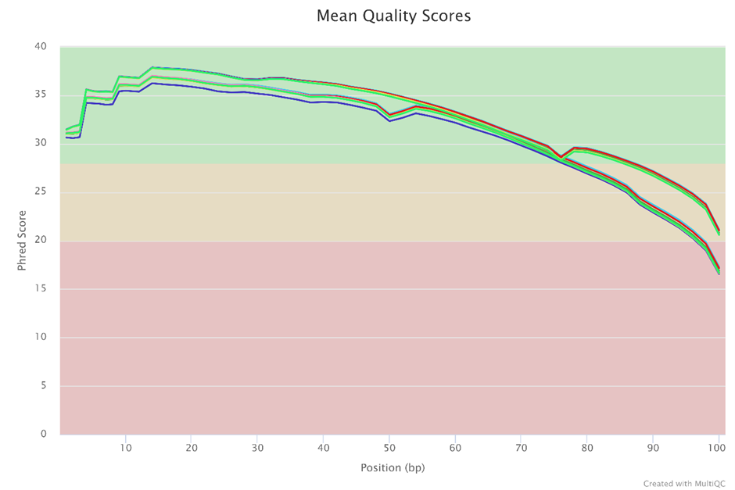
MultiQC report: FastQC
Overview of range of quality values across all bases at each position in fastq files
High scores
High quality base call
Quality degrades as run progresses – as expected
Notes:
N.B. I will be creating a key for the sequences based on the colours

Slide 5
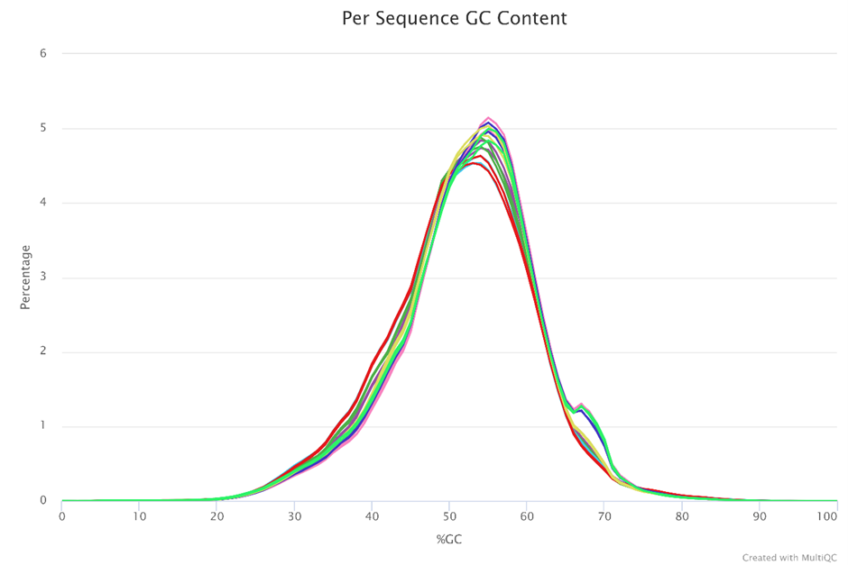
MultiQC report: FastQC
Normal distribution of GC content expected
Notes:
In a normal random library you would expect to see a roughly normal distribution of GC content. An unusually shaped distribution could indicate a contaminated library or some other kinds of biased subset.

Slide 6
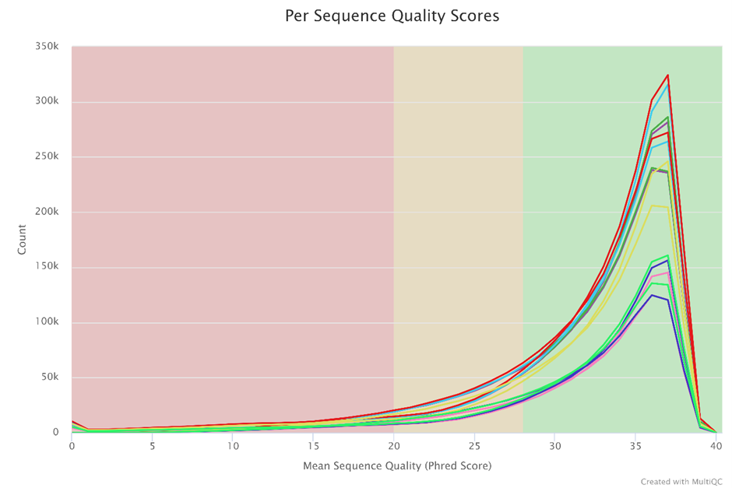
MultiQC report: FastQC
Assess whether subset of sequences have universally low quality scores

Slide 7
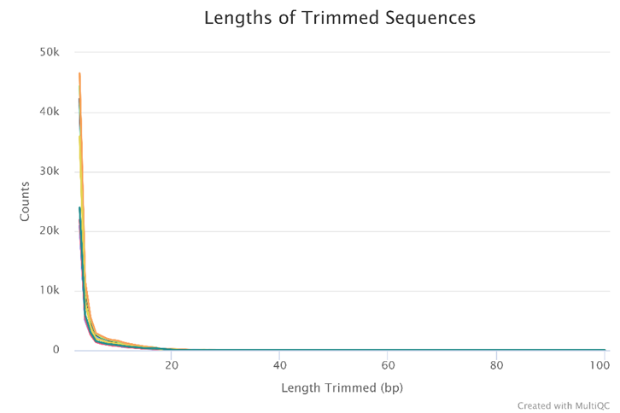
MultiQC report: Cutadapt
Number of reads with certain lengths of adapter trimmed
Shows trimming of specified adapters across all samples
Notes:
Adaptors were 33 bp so why is the length trimmed below 20?

Slide 8
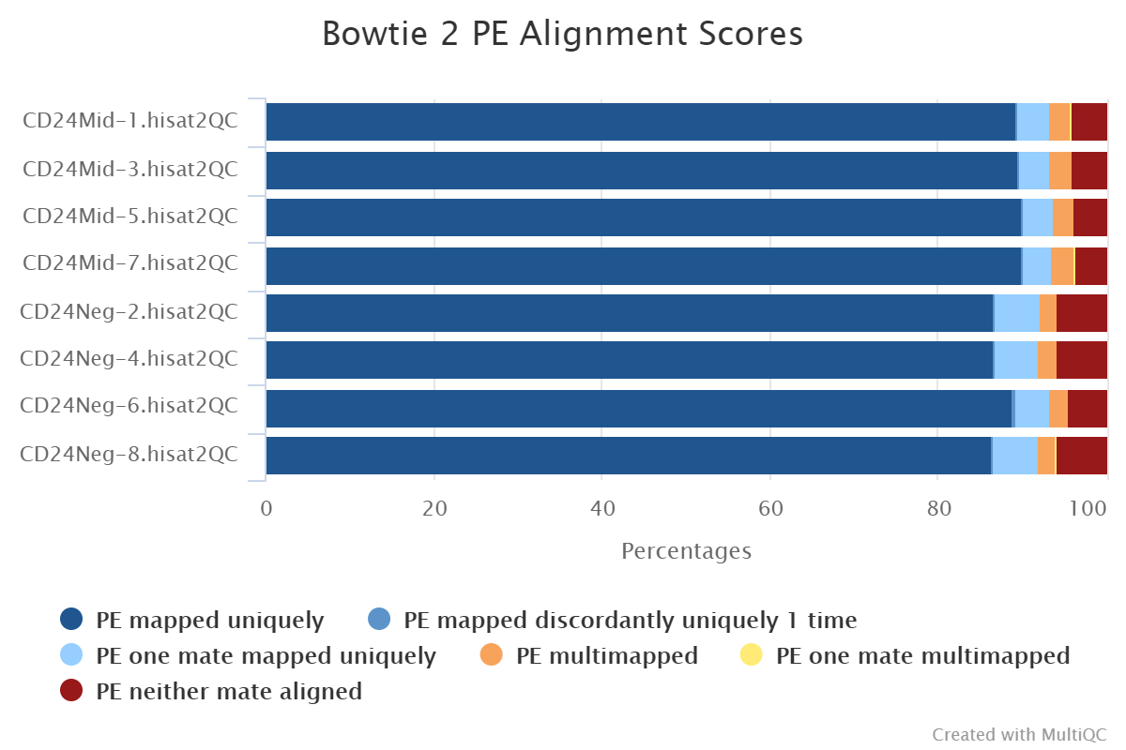
MultiQC report: Hisat2
Hisat 2
High percentage of reads were mapped uniquely to reference genome

Slide 9
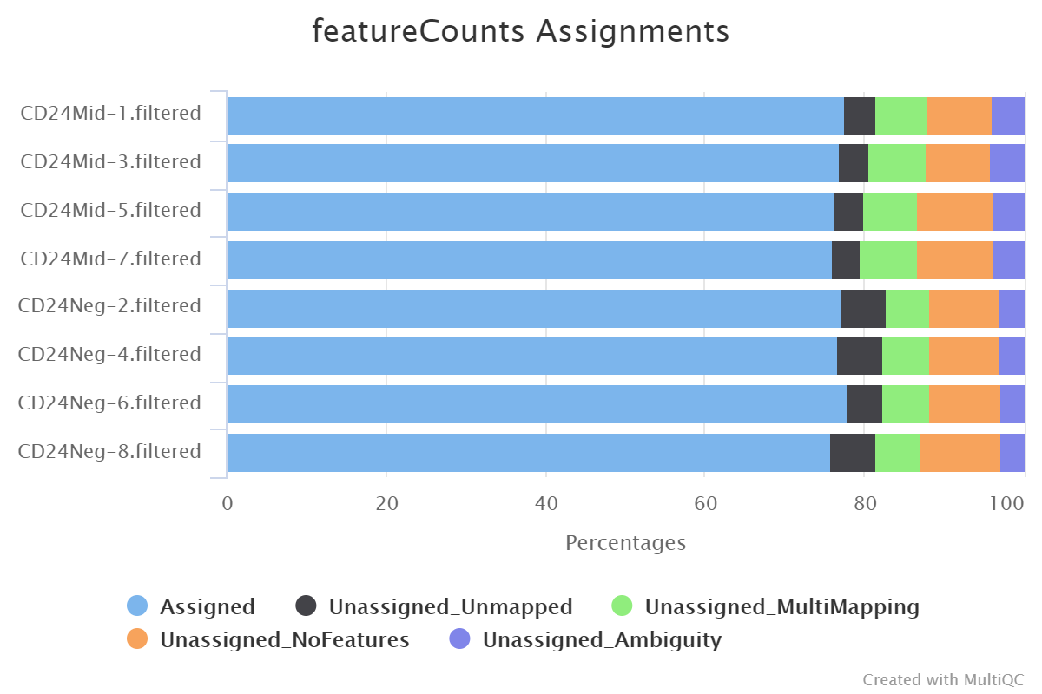
MultiQC report: featureCounts
High percentage of reads were assigned to genomic features (genes)
Notes:
QC results for feature counts show that greater than 75% of the mapped reads were assigned to genes across all sample groups.

Slide 10
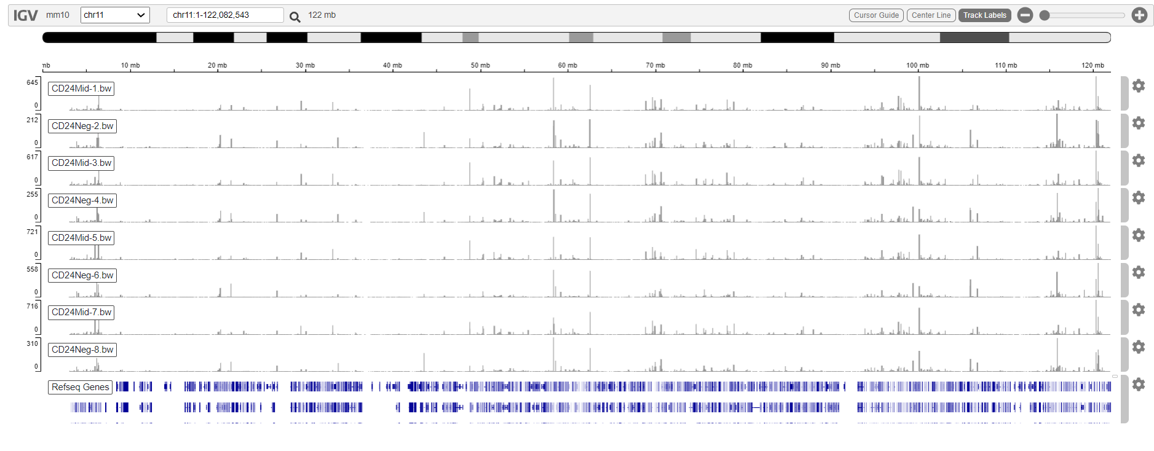
Data visualisation and exploration
Coverage track of mapped reads to mm10 chromosome 11
Notes:
The BAM formatted files were converted to bigwig. format so that the coverage track of mapped reads to chromosome 11 of the mm10 mouse genome could be visualised.

Slide 11
Data visualisation and exploration
Coverage track of mapped reads to mm10 chromosome 11
Notes:
The BAM formatted files were converted to bigwig. format so that the coverage track of mapped reads to chromosome 11 of the mm10 mouse genome could be visualised.

Slide 12
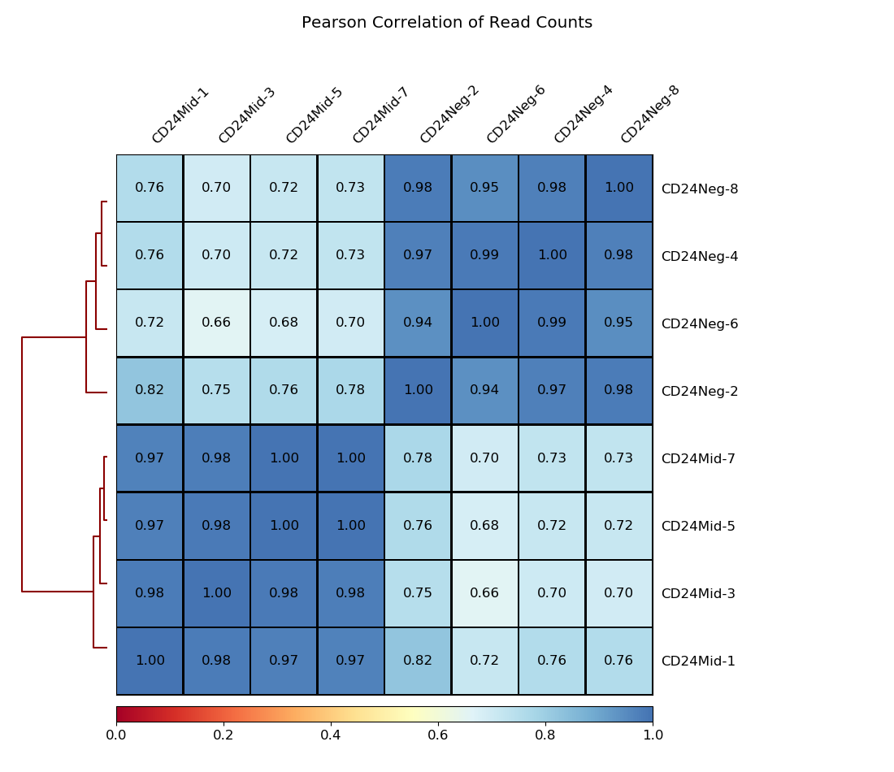
Data visualisation and exploration: multiBamSummary - plotCorrelation
Overall similarity between two or more files based on read coverage within genomic regions
Strong positive correlation between sample groups
Clear separation between sample groups/clustering of samples within same group
Notes:
I ran multiBamSummary on the BAM files and used the plotCorrelation function

Slide 13
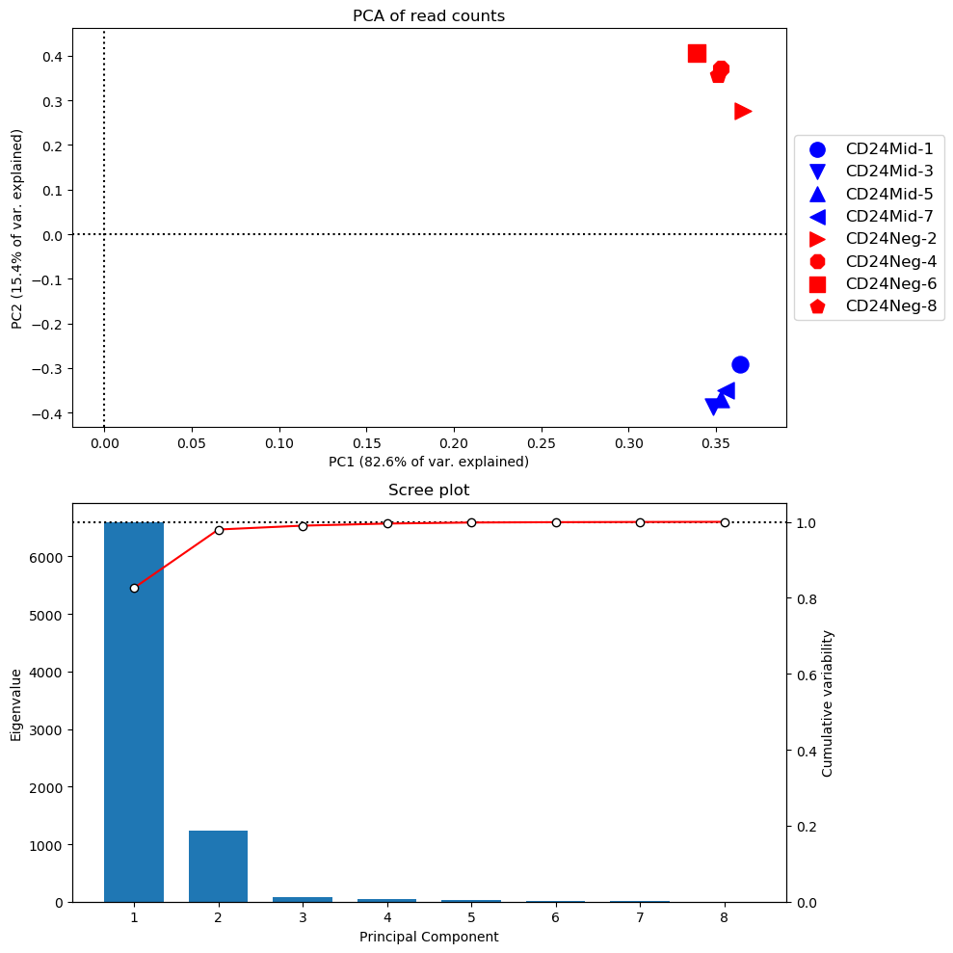
Data visualisation and exploration: multiBamSummary - plotPCA
Samples display greater variability between CD24Mig and CD24Neg groups than between samples in the same group
Notes:
I also used the plotPCA function for the multiBamSummary to show that there was greater variability between the sample groups than between the 4 samples within each group.
See very clear separation between the sample groups and clustering of the samples in the same group.
Interpreting scree plot?

Slide 14
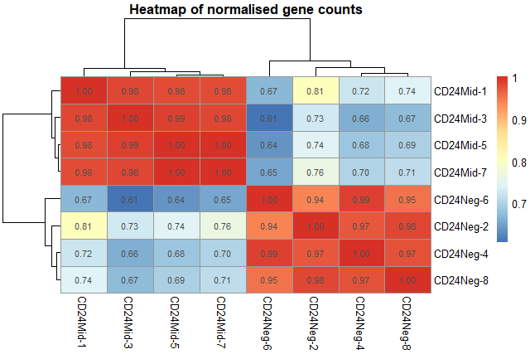
Gene counts: pheatmap
Strong positive correlation between CD24Neg samples
Clear separation between sample groups and clustering of samples within same group
Notes:
After using feature counts to generate my list of gene counts and generating my DGEList, I used pheatmap(cor()) function to show the correlation of the gene counts between the samples within the same group.

Slide 15
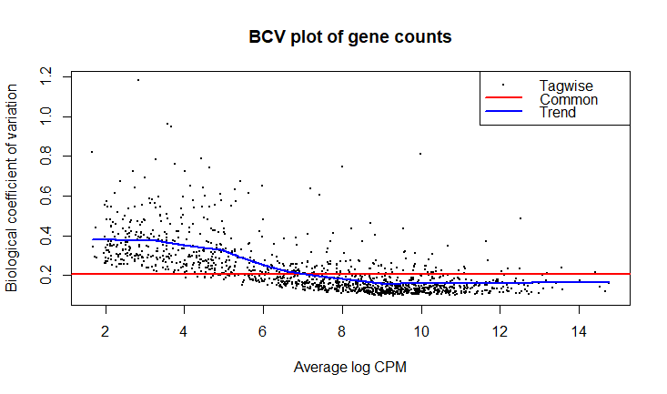
Gene counts: BCV plot of normalised gene counts
The trended dispersion shows a decreasing trend with expression level
Common dispersion is just above 0.2 (0.2-0.4 is considered reasonable)
Expected trend observed
Biological variability decreases with higher expression
At lower counts the dispersion/variability is greater
Notes:
I then filtered and normalised my gene counts and estimated the common dispersion.
To compute differences between groups edgeR estimates the biological variability (between replicates).
Genes with lower counts tend to have a higher variability (noise tends to remain constant so there is a lower signal:noise ratio at lower gene counts).

Slide 16
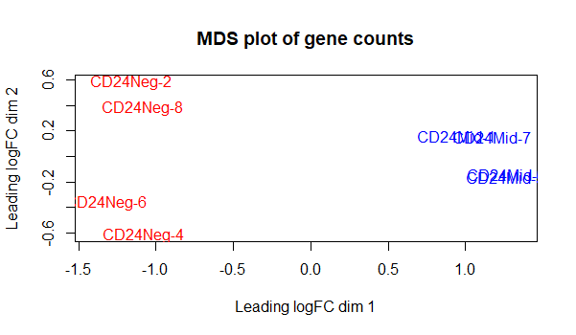
Gene counts: Multidimensional Scaling (MDS) plot
Clear differentiation between the sample groups when the common dispersion is low (seen in BCV plot)
Implies greater variation between groups than within then, as expected
Notes:
Multidimensional scaling plot

Slide 17
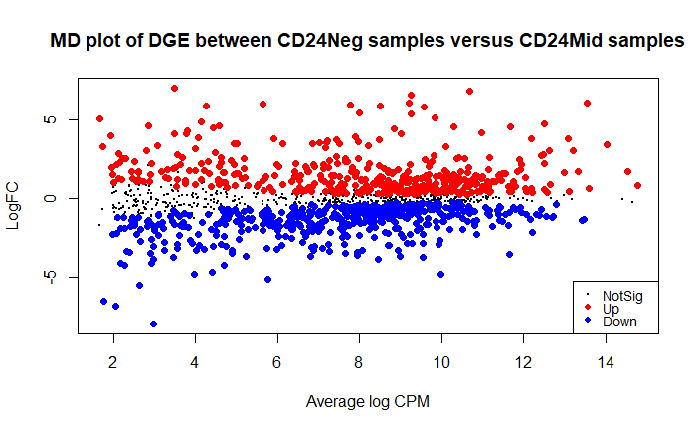
DGE between sample groups: Mean difference (MD) plot
Results from exactTest of the DGEList portrayed in MD plot
423 up
468 down
413 not significant
Notes:
I created a mean difference plot to show the distribution of genes that were significantly up or down regulated and those that showed little change or did changed but not significantly.
Of the 1304 differentially expressed genes 699 genes were expressed higher in CD24Mid samples and 605 were expressed higher in CD24Neg samples.
Of the genes that were significantly differentially expressed, 423 were up regulated, 468 were downregulated and 413 were not significant (shown by dots on the MD plot).

Slide 18
DGE: List of top significantly DE genes with an increase in logFC
Notes:
Table shows top 10 most significantly DE genes with increased logFC.

Slide 19
DGE: List of top significantly DE genes with a decrease in logFC
Notes:
Table shows top 10 most significantly DE genes with decreased logFC
I also have a table of top significant DE genes (more have +ve logFC than –ve)

Slide 20
GO analysis: Top significant GO terms sorted by P.Up
P.Up is the p-value for over-representation of GO term in up regulated genes
Notes:
I then performed GO analysis and this table shows the top 20 GO terms sorted by P.UP which is the p value for over-representation of a GO term in up regulated genes.

Slide 21
GO analysis: Top significant GO terms sorted by P.Down
P.Down is the p-value for over-representation of GO term in down regulated genes
Notes:
And this table shows the top 20 GO terms sorted by P.Down which is the p value for over-representation of a GO term in down regulated genes.

Slide 22
KEGG analysis: Top significant KEGG pathways sorted by P.Up
Notes:
I also carried out KEGG pathway enrichment analysis. Of the top KEGG terms sorted by P-Up 13 pathways were significant.
TNF signalling pathway – intestinal epithelial turnover

Slide 23
KEGG analysis: Top significant KEGG pathways sorted by P.Down
Notes:
15 KEGG terms were significant when sorted by P.down
Wnt target genes have been shown to be expressed in proliferative progenitor crypts and CRC cells → colorectal cancer associated pathways shown to be down-reg in CD24Neg
Hippo - Birc5 significantly downregulated

Slide 24
Next steps…
Notes:
Began to research known genes and pathways associated with intestinal epithelium renewal
I will continue researching the most significant genes – if they are reported in intestinal epithelium renewal I will make speculations and suggestions for further analyses - KOs

Slide 25
Wnt signalling: primary driving force behind epithelial cell proliferation in the intestinal crypts
Wnt signalling often implicated in stem cell control, as a proliferative and self-renewing signal
Axin2, TCF7, Wnt3 and Wnt9b
Significantly DE
Negative logFC (expressed higher in CD24Mid samples)
Notum
Significantly DE
Positive logFC (expressed higher in CD24Neg samples)
Notes:
Wnt pathway was highlighted as a major driver of epithelial cell proliferation.
I looked at genes associated with this pathway and found some gene that were significantly DE.

Slide 26
Other signalling pathways
Hippo pathway – Birc5 significantly downregulated
Colorectal cancer – reports of intestine specific Wnt target genes expressed in proliferative crypt progenitors and CRC cells
TNF signalling – intestinal epithelial turnover
Notes:
These are just a few of the pathways I have begun researching from the table of KEGG pathways.

